Slide 1


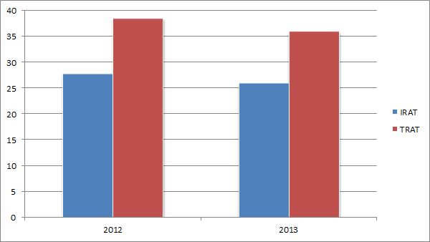
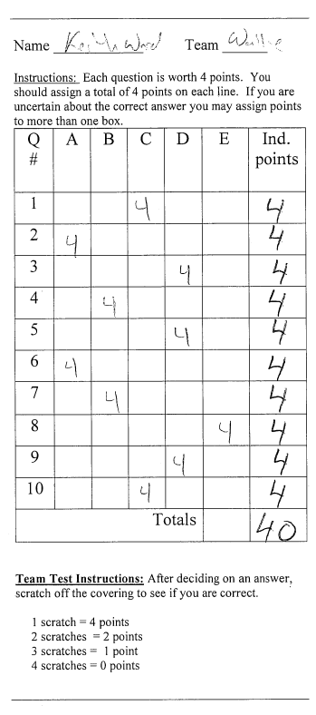
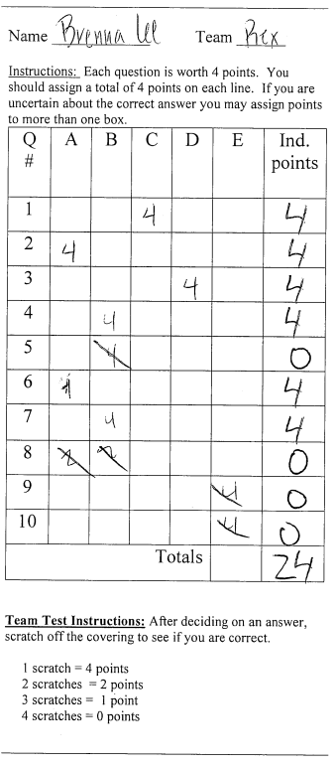
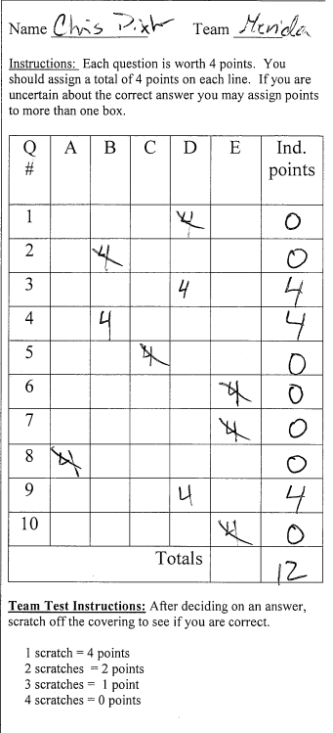
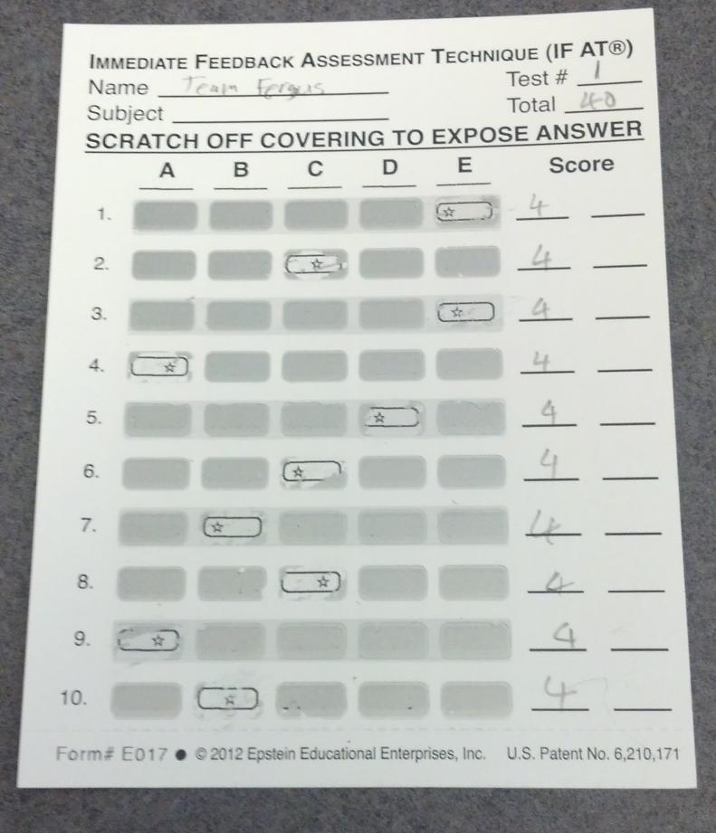
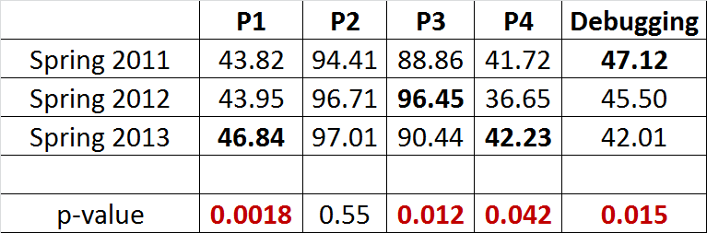
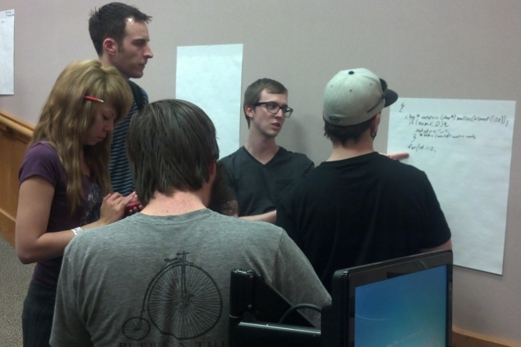
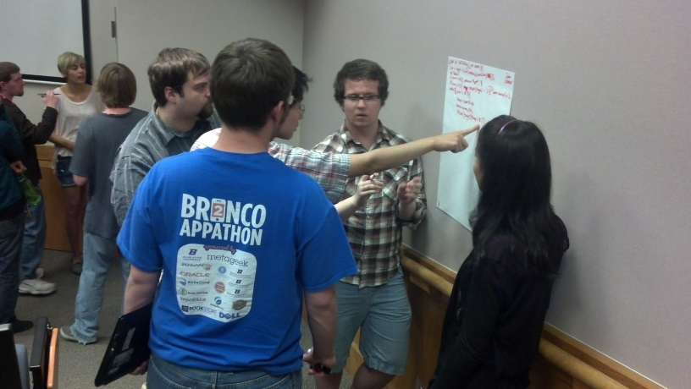
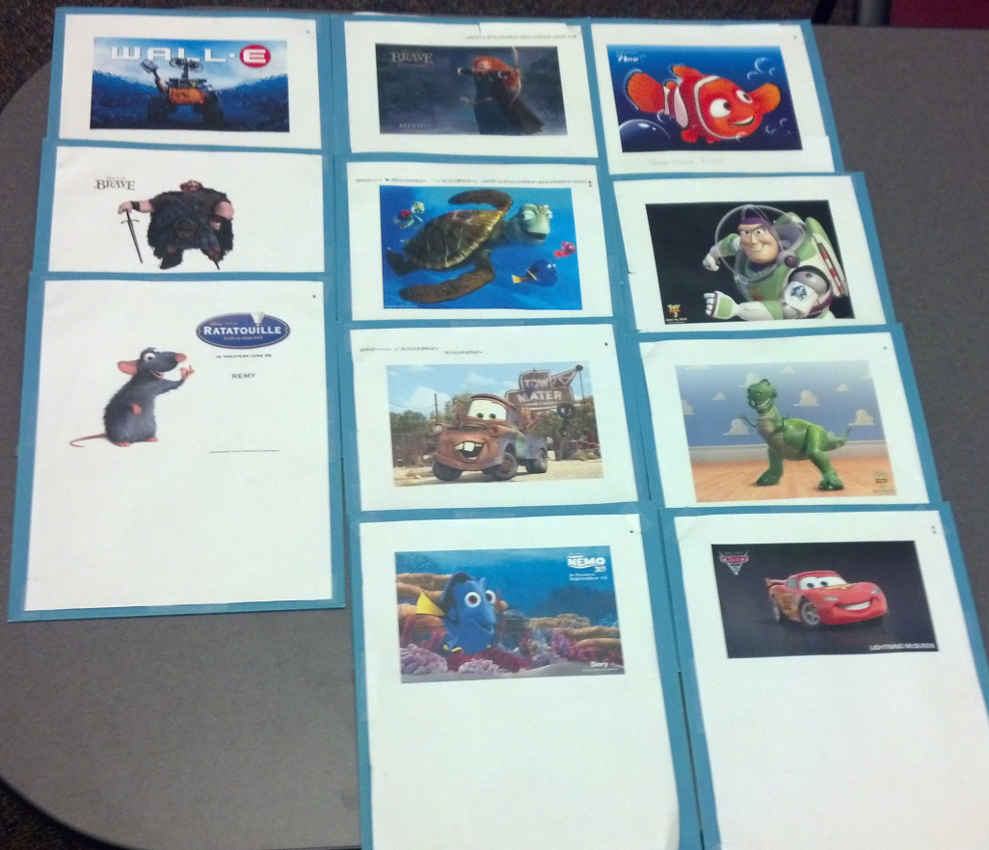

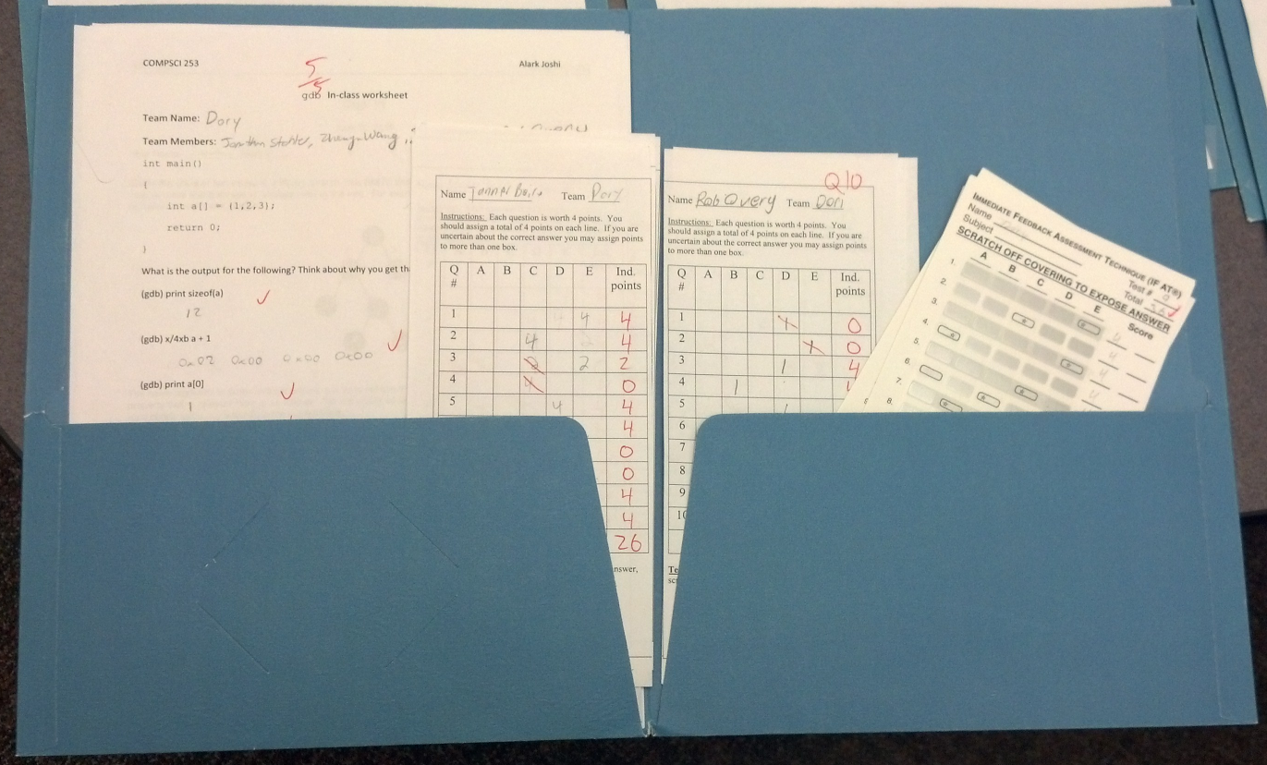

Evaluating Team-Based Learning in a Sophomore Level Programming Class
Alark Joshi
Boise State University, Department of Computer Science, Boise State Teaching Scholars Program
The Teaching and Learning Question
Approach
Findings
Conclusions
Can Team-Based Learning (TBL) be used successfully in Computer Science classes?
Can Team-based learning lead to increased engagement in the classroom and an overall improved understanding?
Can the benefits of TBL be evaluated using ‘traditional’ metrics such as performance on programming assignments?
What do students think about TBL in the classroom?
Evaluate the benefits of TBL in the Object Oriented Program Development in C (COMPSCI 253) class by comparing the offering in Spring 2011 (without TBL) with the offering in 2012 and 2013 (with TBL).
Individual quiz (IRAT) followed by the Team quiz (TRAT)
Team-based problem solving - Identify multiple approaches to a problem and then pick the optimal approach based on a detailed analysis of the strengths and weakness of this approach.
Evaluate the performance of students on the programming assignments that are large, complex and require about two weeks to complete
Examine the use of clickers (through socrative) to get quick, real-time feedback in class
The performance of the students in the Team RAT (Readiness Assurance Test) is consistently better than on the Individual RAT
Comparing the performance of students on the programming assignments through the three offerings in Spring 2011, 2012 and 2013 results in statistical significance (p<0.05) for 4 out of 5 assignments. P4 is the most difficult assignment of the semester. The student performance in 2013 is statistically significant (p=0.042) as compared to Spring 2011 & 2012.
Team-based learning has a statistically significant impact on student performance in 3 of the 5 programming assignments
The mid-semester student survey indicated that 88% of the students thought that the team-based learning activities such as individual quizzes, team quizzes and in-class team activities benefited them and helped them understand the material better.
As expected, students performed better on the TRAT as compared to the IRAT in Spring 2012 and Spring 2013
A new approach needs to be found for the debugging assignment, since the students performed worse for the TBL offerings
Knowledge Base and Context
Most Computer Science classes are taught in the ‘sage on the stage’ style where a professor introduces students to new concepts in class and the students work on programming assignments, homework, and final projects independently through the semester.
Since students are hearing about the material for the first time, class participation is minimal and questions are invariably shallow or go unanswered.
Through TBL, Michaelsen et al. have shown that student engagement can be sustained in large classes. Since, Computer Science students and professors are used to the traditional model of lecturing and independent/group programming, the TBL model is a unique approach to teaching content heavy courses.
Lasserre et al. have implemented TBL in a freshman computer science class. They found that over the years, on average students have performed a letter grade better and the course drop rate has gone down from 30% to 6.4%.
Whittington explored the use of team-based learning in a senior programming languages class. Students performed particularly well and enjoyed working in teams.
Transferability
The flipped nature of the classroom requires students to be prepared for the weekly quizzes and seems to lead to engaged discussions and thoughtful questions in class
Team-based activities in the classroom foster engaged learning and allows future computer scientists to learn how to work in teams
In-class activities allow students to apply their knowledge and gain a better understanding of the concepts rather than just hearing about them in class
Team-Based Learning is perfectly suited for Computer Science courses
Lessons Learned
Teams of 5 students is optimal. 6 can work, but 7 is definitely a crowd and leads to slacking
Based on the mid-semester survey, students want more in-class programming activities
Team folders are indispensable for collection and dissemination of quizzes and in-class activities.
References
P. Lasserre. Adaptation of team-based learning on a first term programming class. In Proceedings of the 14th annual ACM SIGCSE conference on Innovation and technology in computer science education, ITiCSE ’09, 2009.
P. Lasserre and C. Szostak. Effects of team-based learning on a cs1 course. In Proceedings of the 16th annual joint conference on Innovation and technology in computer science education, ITiCSE ’11, 2011.
L. Michaelsen, A. Knight, and L. Fink. Team-based learning: A transformative use of small groups. Praeger Publishers, 2002.
K. Whittington. Understanding the tbl divide; examining similarities and differences between writing and programming. In TBL conference. Vancouver (June 2007)(http://tbl. apsc. ubc. ca/conferences/2007/# 1), 2007.

